Slide 1
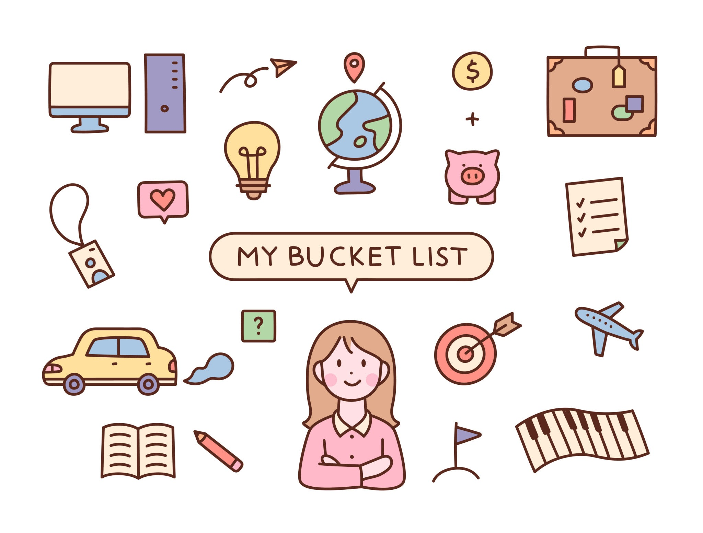
HobbyCircles
By: Yasmin Castro and Ashley Crespo

Slide 2
What is it?
HobbyCircles connects people to local and online communities based on shared interests (hiking, coding, book clubs, etc.).
It solves the problem of hobby groups being scattered across multiple platforms by making it easy to find, join, and manage events in one place.
Users:
Consumers: join groups, RSVP, leave reviews
Providers: create/manage groups and events, track RSVPs, see reviews

Slide 3
Provider
Main functionalities for the Provider (Host):
Create Profile
Create an Event
Manage my Events
View Reviews
Demo:
file:///Users/folder/Library/CloudStorage/OneDrive-UNCG/CSC340/SUM26-Team5/high-fidelity-prototype/provider/reviews.html
https://github.com/Apple-211/SUM26-Team5

Slide 4
2. Customer
Website/app Main page: The first thing anyone sees. Introduces HobbyCircles and gives new people a way to log in, sign up, or start browsing groups without an account yet.
Create Profile: Where a new user builds their account: name, email, password, profile photo, hobbies/interests, and location. This is the starting point the hobbies and location entered here are what later connect a user to relevant groups near by.
Login: Lets a returning user sign back into their existing account.
Home Base: The main screen after logging in. Shows how many groups the user has joined and what events they've RSVP'd to, so they can see where they stand at a glance.
Find and Join Groups: The core discovery page. Users search by interest or location, see matching groups with details like location and member count, and can join a group or RSVP to one of its events.
Leave a Review: Lets a user pick a group they've joined, rate it, and write feedback about their experience.
https://github.com/Apple-211/SUM26-Team5/tree/main/high-fidelity-prototype/customer

